Slide 1

UNIT 1: Who am I?
The family photo

Slide 2
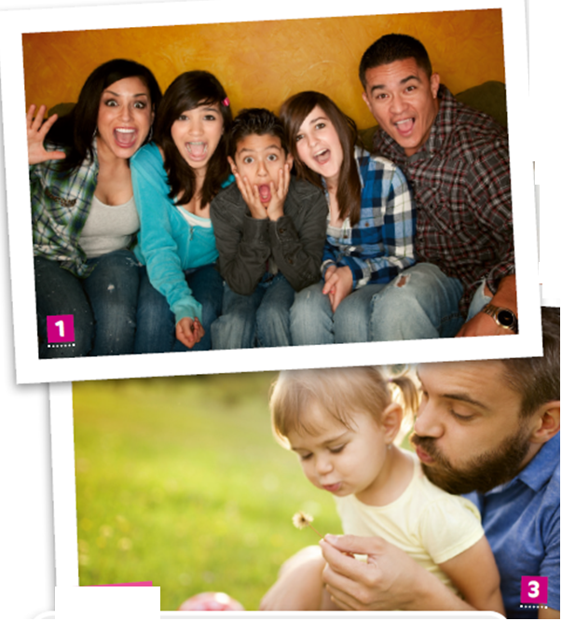

Look at the photos and describe them.
Who can you see?
Where are they?
What are they doing?

Slide 3
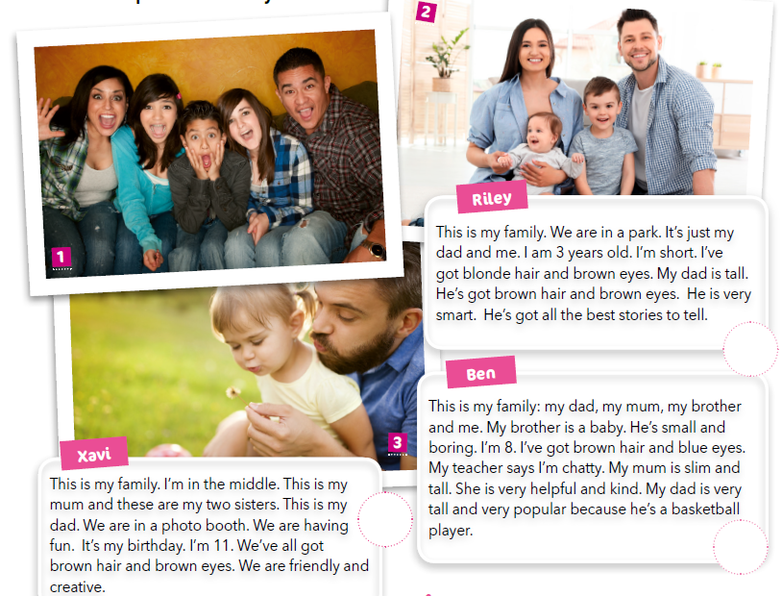
Look at the texts. What are they about? Read them and match them with photos.
3
1
2

Slide 4
Translate:
photo booth -
chatty -
smart -
kabina za fotografiranje
pričljiv, brbljav
pametan

Slide 5
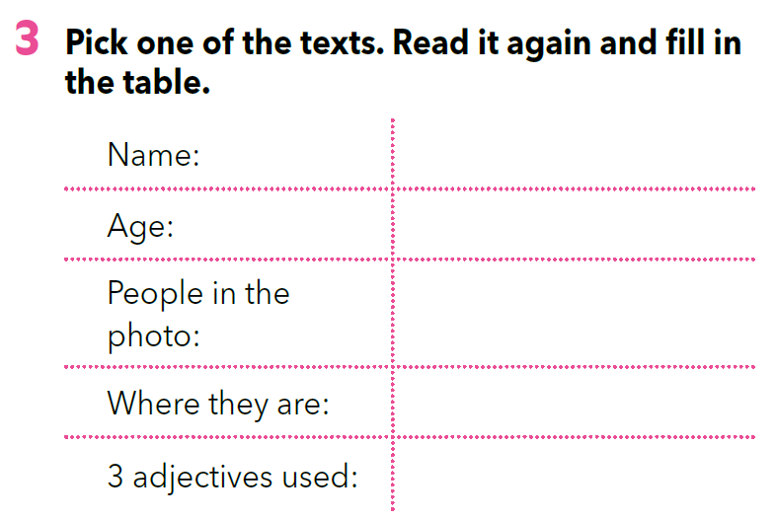
Use the information from the chart and retell the text.

Slide 6
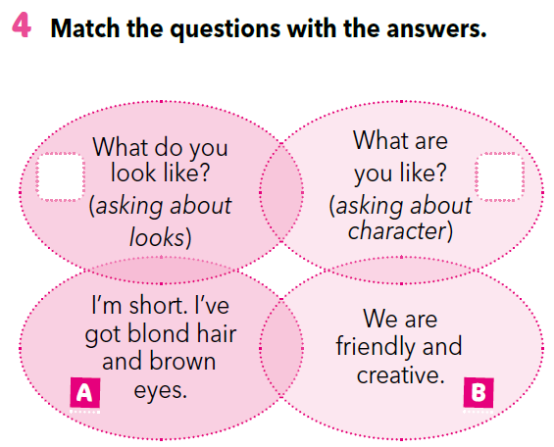
Look at the questions.
What do you look like?
What are you like?
Kako izgledaš? (fizički izgled)
Kakva si osoba? (osobine)
Match the questions with answers.
A
B

Slide 7
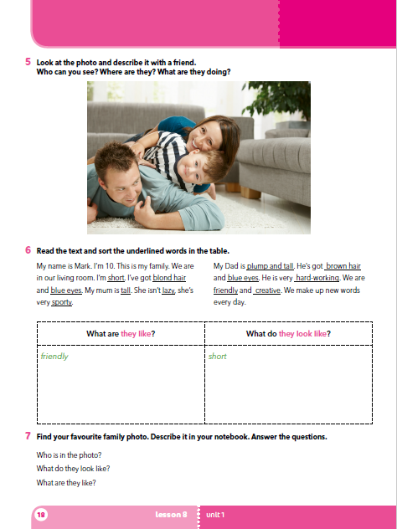
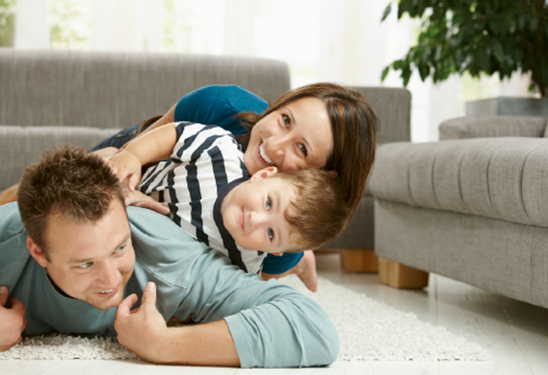
Look at the photo and describe it.
Who can you see?
Where are they?
What are they doing?

Slide 8
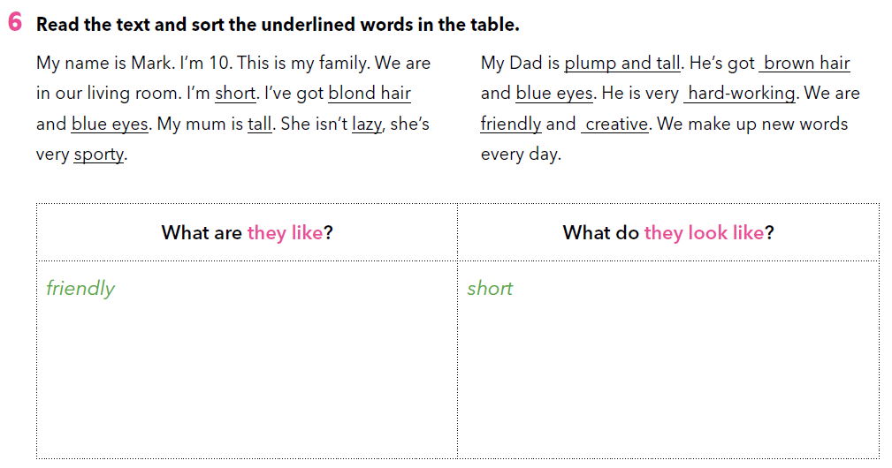
Read the texts and sort the underlined words into the right category.
lazy
sporty
blond hair
blue eyes
creative
tall
plump and tall
hard-working
brown hair

Slide 9
Let’s practise!
Read the sentences and sort them into the right category:
What do they look like? or What are they like?
https://learningapps.org/view5198694

Slide 10
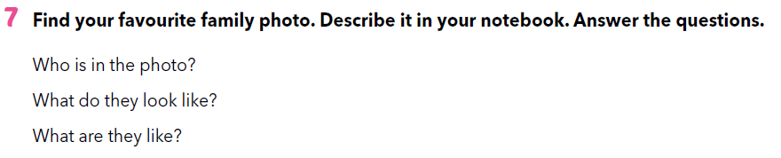
Find your favourite family photo. Then describe the photo in your notebook. Answer the questions.
Who is in the photo?
What do they look like?
What are they like?

Slide 11
Let’s practise!
https://www.e-sfera.hr/dodatni-digitalni-sadrzaji/119c40dd-4f52-4318-b346-4d7d801f8438/
Look at the pictures and describe them. Choose the correct answer.

Slide 12
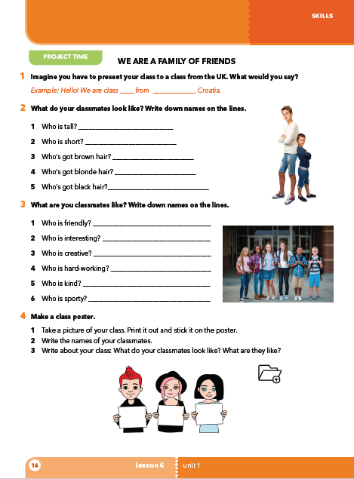
PROJECT TIME
Imagine you have to present your class to a class from the UK. What would you say?
e.g. Hello! We are class _____ from ______, Croatia. …

Slide 13
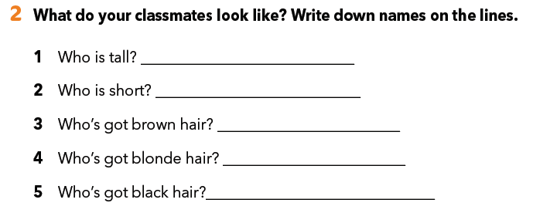
PROJECT TIME

Slide 14
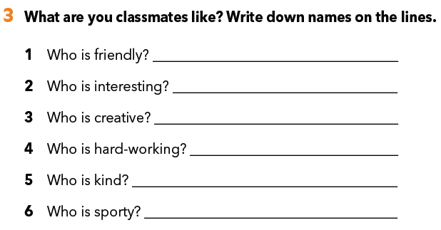
PROJECT TIME
What are your classmates like? Write down the names on the lines.

Slide 15
PROJECT TIME
Make a class poster.
Take a picture of your class. Print it out and stick it on the poster.
Write the names of your classmates.
Write about your class: What do your classmates look like? What are they like?

